Slide 1

Text2graphAPI: an API to transform text documents into text graphs
DISCA-IIMAS
Andric Valdez
13/09/2023
andric.valdez@gmail.com
Notes:
NOTES
- Hello everyone
- My name is Andric Valdez, it’a a pleausure to be here
- I am a phD student in computer science in the IIMAS department
- Today I’m gonna present an API/Library called Text2graphAPI, used to transform text documents into text graph

Slide 2
Content
Introduction
Text2graphAPI
Usage of text graphs
Hands-On
Example
<Notebook>
Notes:
- So, this is the content I would like to share with you today, it consist of 4 main points
- I’ll start with some introduction related to feat extraction in text data (from the traditional methods to text graph reprsentations)
- second point, introduce to the library text2graphAPI (the design and main funcionalities)
- third point, talk about the usage of text graph in the literature (presents some interesting works related to the authorship analysis using text graph)
- lastly, share with you a hand-on example (colab notebook)

Slide 3
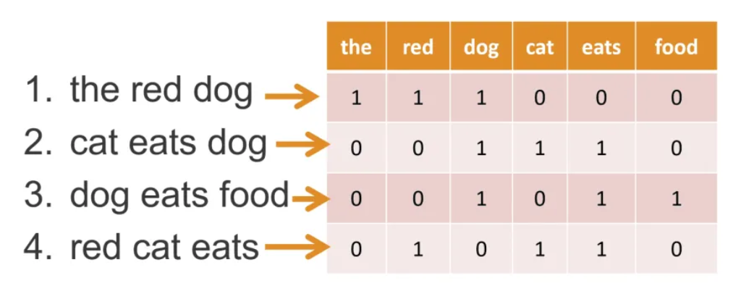
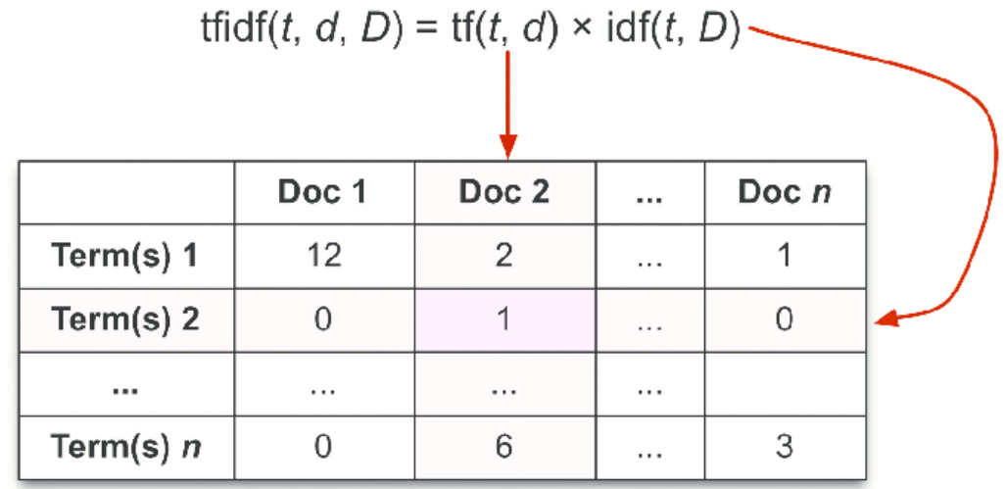
Introduction
Feature extraction in textual data
Term frequency –
Inverse document frequency (TF-IDF)
Bag of Words (BOW)
Notes:
- As we know there are many ways/tech for feat ext in textual data, that is, form to represent texto documents into numeric vector, that we can use maybe to train a model. two of the most popular or used in the community are:
- BOW: built a vocabulary based on the corpus and then generate vector of 1,0 values for each documents
- TF-IDF: it’s a metric/measure that express the relevance of a Word for a document

Slide 4
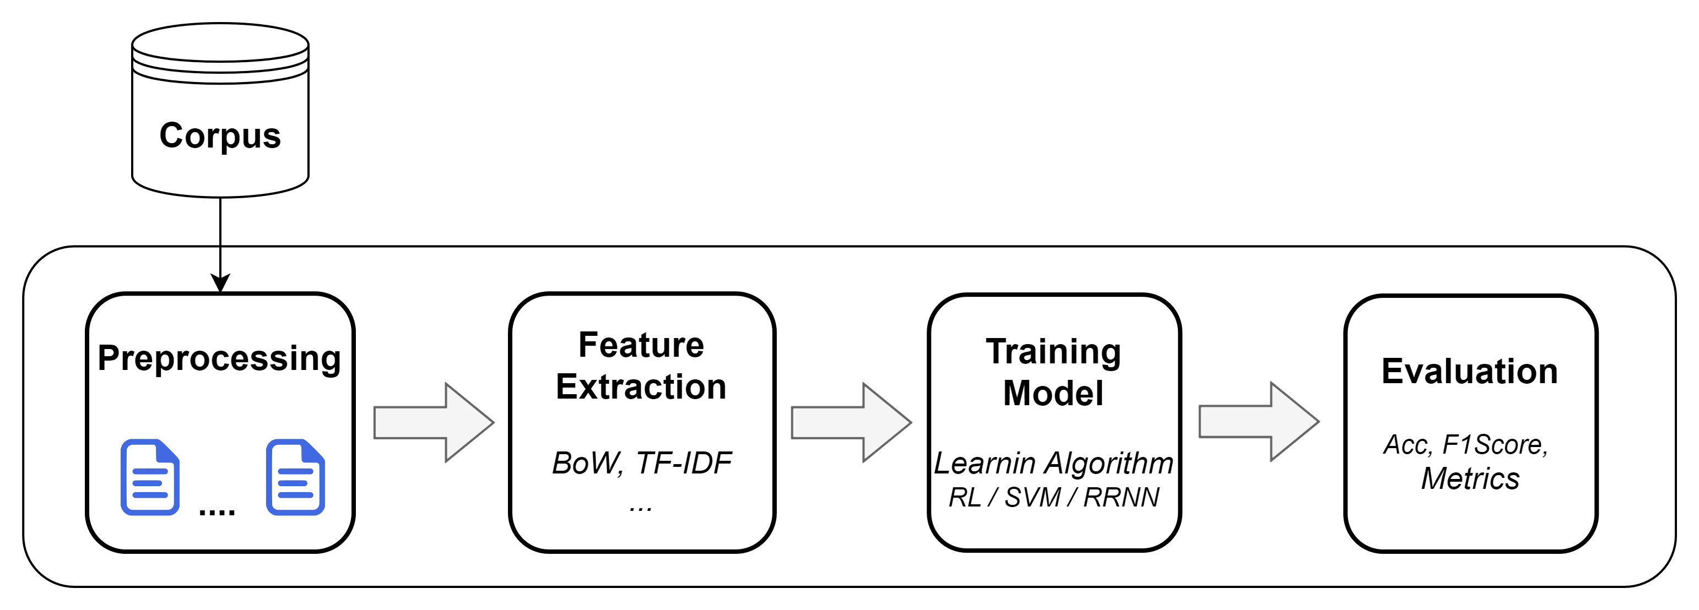
Clasification models using traditional methods
General pipeline to build a text clasification model
Notes:
- now, with that in mind
- Commonly we use this types of traditional techniques (BoW, TFIDF) to build clasification models
- This diagram shows a general pipeline to build a text clasification model: Corpus / Preprocessing/Feature extracción/Training/Classifier/Evaluation
- But, this performance that the classification model could have depends to a large extent on this feature extraction component, since it is here where the vector representations are built, and, as I said these are used to feed the learning model
- However, these tradicional methods such as BoW in most scenarios tend to be deficient, since the characters / features of the text are not being extracted in the best way, also, with this approach a lot of effort/times goes in desgining proper features, propers ways to captures the structure of the data
- And that is why in recent years new techniques/methods has emerged in order to addressing the deficiencies presented by these traditional approaches: One of them is text graph representation
- The idea behind text graph is to focus on how to represent text documents in the form of graphs in order to exploit the characteristics (features) in the best way and be able to model relations and structural information of the texts in an effective way.

Slide 5
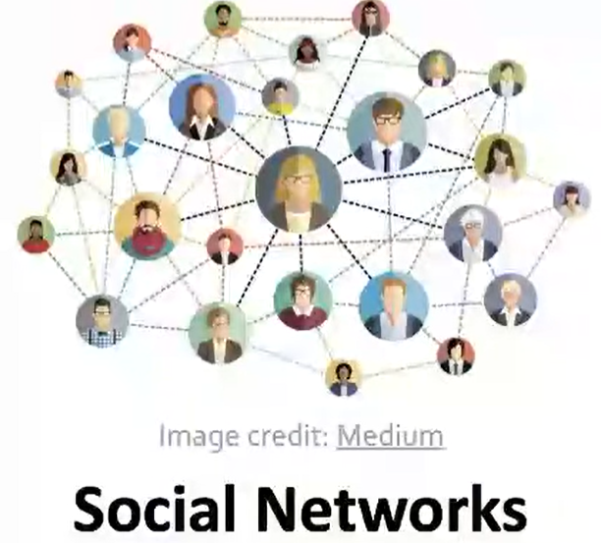
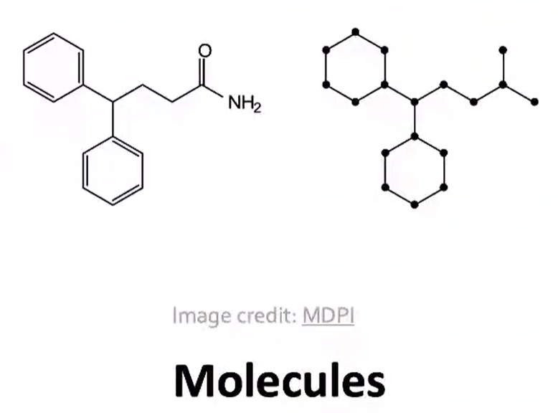
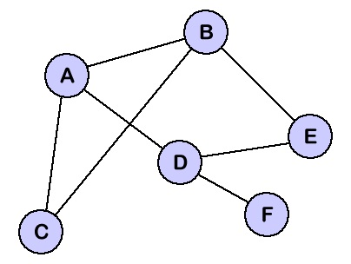
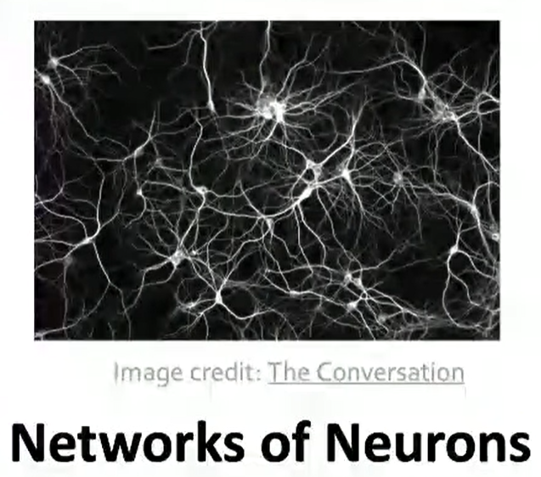
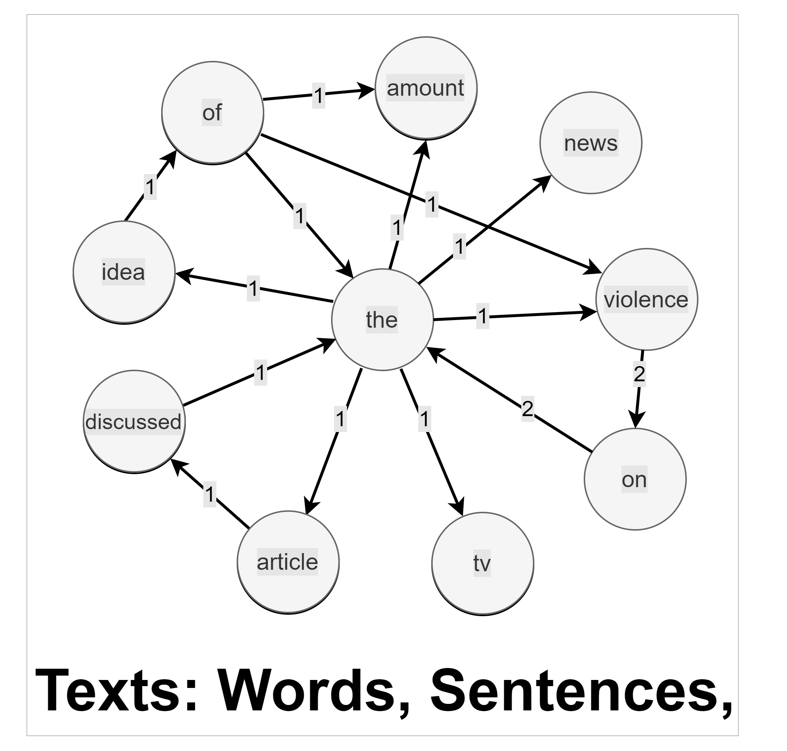
Introduction - Graphs
General language for describing and analyzing entities with relations/interactions
Notes:
- So now lets talk abouut graph
- Now, as a very brief and basic introduction about graphs, we can define them as
- So, We can have a set of entities or nodes (A, B, C) and their relationships between two nodes as edges
- The graphs are widely used in different areas
- there are many type of data that can naturally be represented as graphs, and modeling this graphical relation, to mention some example
- Explain examples of Social Networks, Molecules and Network of Neurons
- there are other domains that has relations structure
- Finally, the text document: A text can be properly represented as a graph using words as nodes and the edges represent the significant relationship between the nodes.

Slide 6
¿How do we take advantage of relational structure to make better predictions?
Complex domains have rich relation structure, which can be represented as a relational graph.
By explicitly modeling relationships we could achieve better performance.
Notes:
- maybe you are wondering
- How do we take advantage of relational structure to make better/accurate pred
- complex domains have rich relation structure, which can be represented as a relational graph
- By explicitly modeling relationships we could achieve better performance

Slide 7
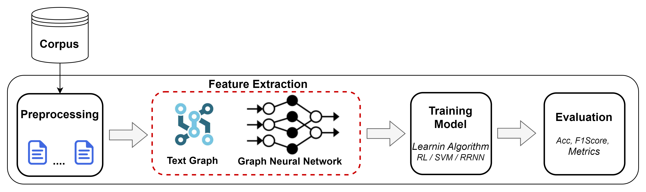
Clasification models using graphs
General pipeline to build a text clasification model using text graphs
Notes:
- It is precisely this approach of text graphs that we can use in order to exploit the textual features in the best way and be able to model relations and structural information of the texts in an effective way.
- Explain the pipeline…

Slide 8

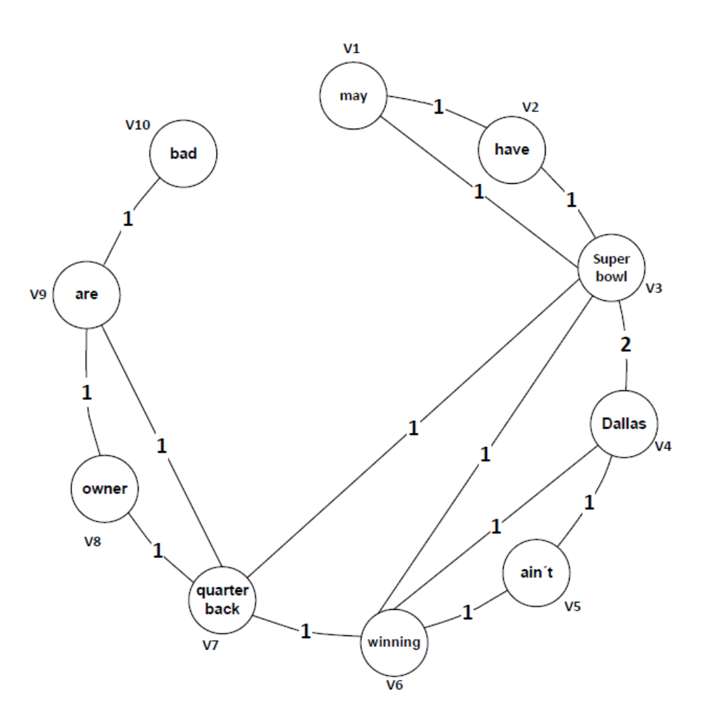
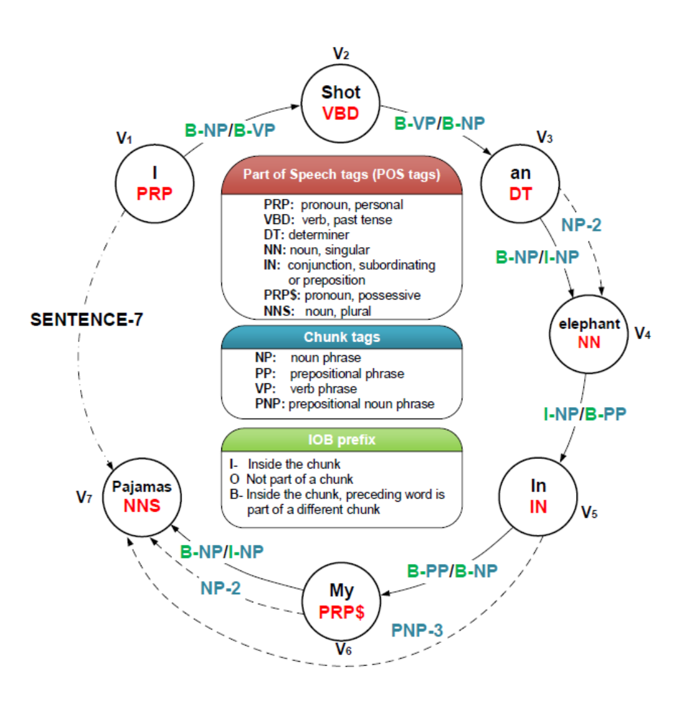
Text to Graph transformation
Implement this transformations it is not an easy task
Implies to consider different factors: Preprocessing, Modeling Graph, Outputs
Build a software that encapsulate the main functionalities
Different graphs representations
Notes:
- However, to accomplish/implement this transformation from text to graph it’s not an easy task,
- Because it implies to consider different factors such as: cleaning and normalizing the text, model and build the nodes and edges of the graph, get a proper output from the graph, etc.
- This is why we decided to design and build software APIs/libraries that encapsulate the main functionalities for this transformation (text to graph) in order to perform them in a simpler, faster and more flexible way.

Slide 9
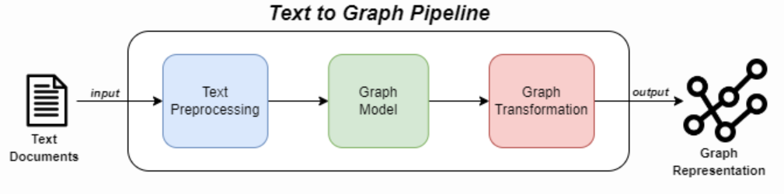

Text2graphAPI
Library to transform text documents into text graphs
Currently supports two types of graph representations
Co-Ocurrence Graph
Heterogeneous Graph
Composed of three main modules :
Pre-processing: text cleanning and normalization (spacy, nltk)
Graph Model: define/build nodes and edges according to the specifications
Graph Transformation: transform to text graph representation (networkx, adj matrix)
https://pypi.org/project/text2graphapi/
Notes:
- now, let's talk about the library, the design and the main components
- Library to transform text documents into text graphs
- Currently supports two types of graph representations
Co-Ocurrence Graph
Heterogeneous Graph
- Composed of three main modules :
Pre-processing: text cleanning and normalization (spacy, nltk)
Graph Model: define/build nodes and edges according to the specifications
Graph Transformation: obtain properly output for the graph: networkx, adj matrix

Slide 10
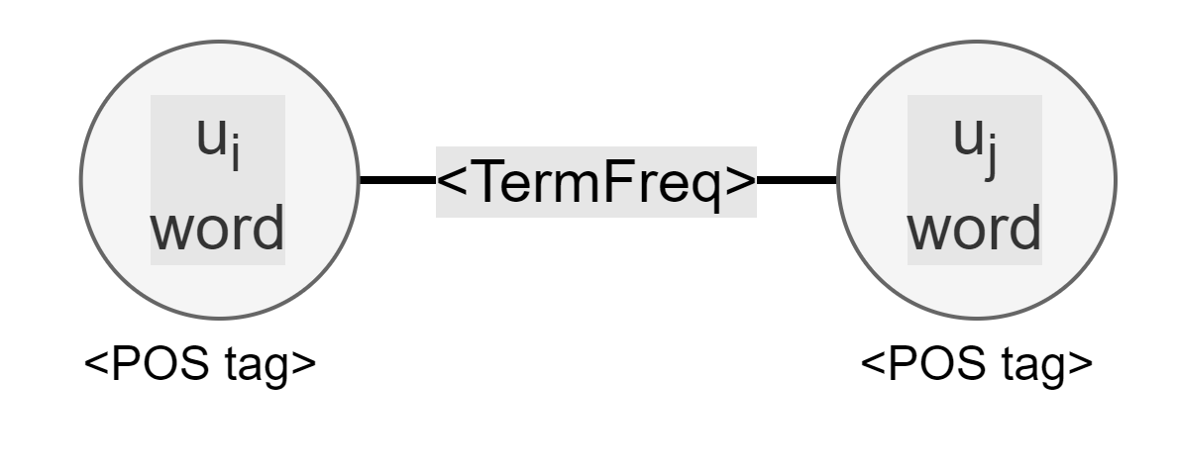
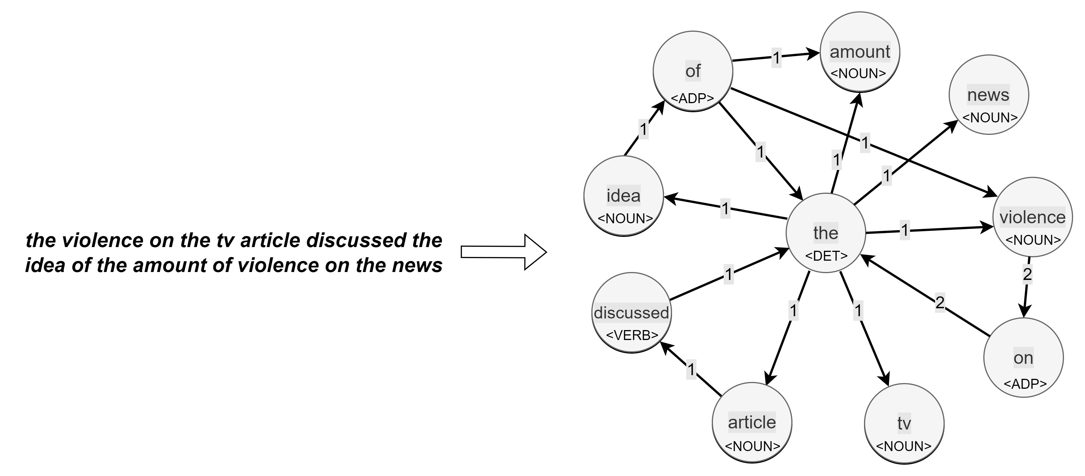
Text2graphAPI - Co-Ocurrence Graph
Per 1 input document generates 1 graph as an output
Entities and relations are built as:
Nodes: each word from the document
Edges : co-occurrence of two words from the document
Weights are built as:
Nodes: Part of Speech tag (POS)
Edges: Co-ocurrence frequency
Notes:
The first representation supoprted is the Co-Ocurrence Graph
Per 1 input document generates 1 graph as an output
Entities and relations are built as:
Nodes: each word from the document
Edges : co-occurrence of two words from the document
Weights are built as:
Nodes: Part of Speech tag (POS)
Edges: Co-ocurrence frequency

Slide 11
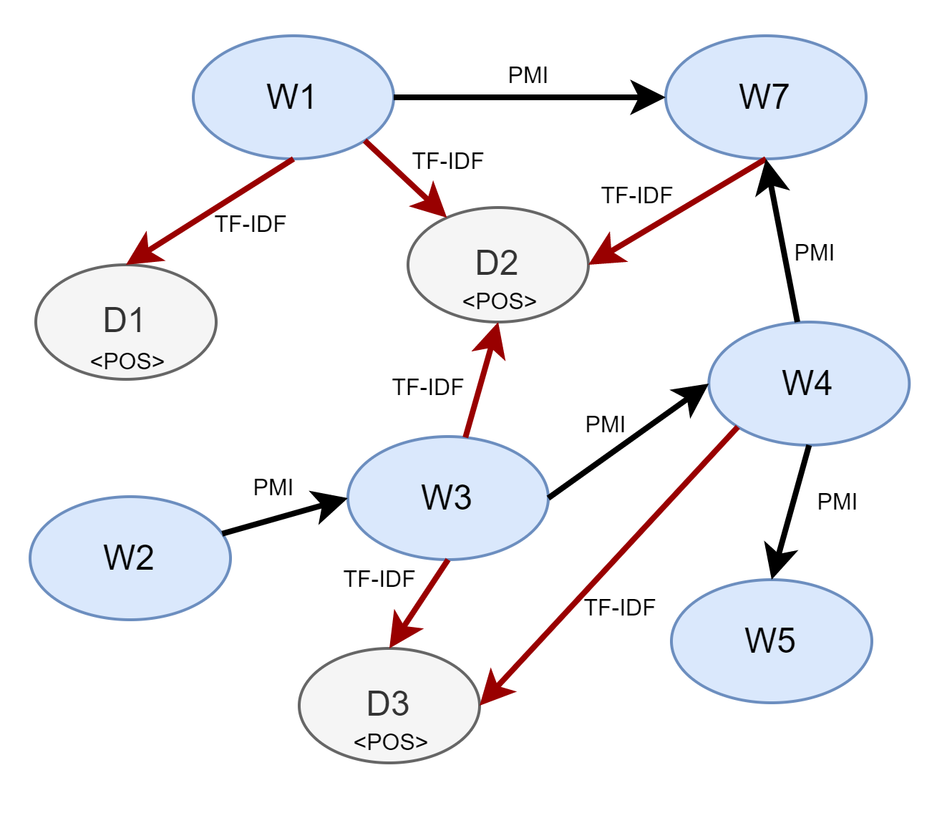
Text2graphAPI – Heterogeneous Graph
For multiple input documents (corpus) generates 1 graph as an output
Entities and relations are built as:
Nodes: each Word and each Document (corpus)
Edges: Word-Word for co-occurrence and document-word when the word appears in the document
Weights are built as:
Nodes: Part of Speech tag (POS) for Word nodes
Edges: PMI value for Word-Word relation and TF-IDF value for Document-Word relation
Notes:
And the second representation supoprted is the Heterogeneous Graph
For multiple input documents (corpus) generates 1 graph as an output
Entities and relations are built as:
Nodes: each Word and each document (corpus)
Aristas: Word-Word for co-occurrence and document-word when the word appears in the document
Weights are built as:
Nodes: Part of Speech tag (POS) for Word nodes
Edges: PMI value for Word-Word* relation and TF-IDF value for Document-Word relation
* point-wise mutual information (PMI), very popular metric to measure the association between two words

Slide 12
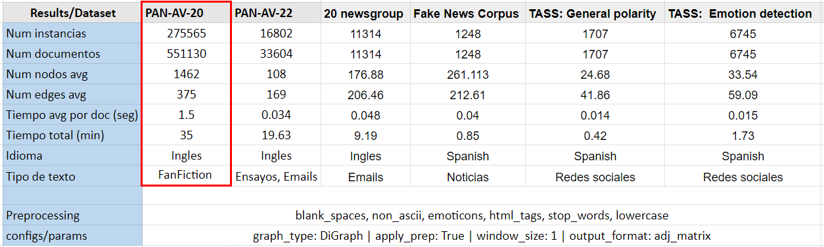
Testings for differents datasets using Text2graphAPI
Co-Ocurrence Graph
Notes:
- now let's see some testing results using the library for different datasets
- Exaplain table…
- We wanted to observe the transformation time, and explore the graphs obtain as an otputs
- So, for example for the PAN 2020 (that it is a big dataset, that has 500 hundred k documents), each of this documents on average obtained a graph with 1,462 nodes and 375 edges, and the total time for the whole corpus took 35 minutes

Slide 13
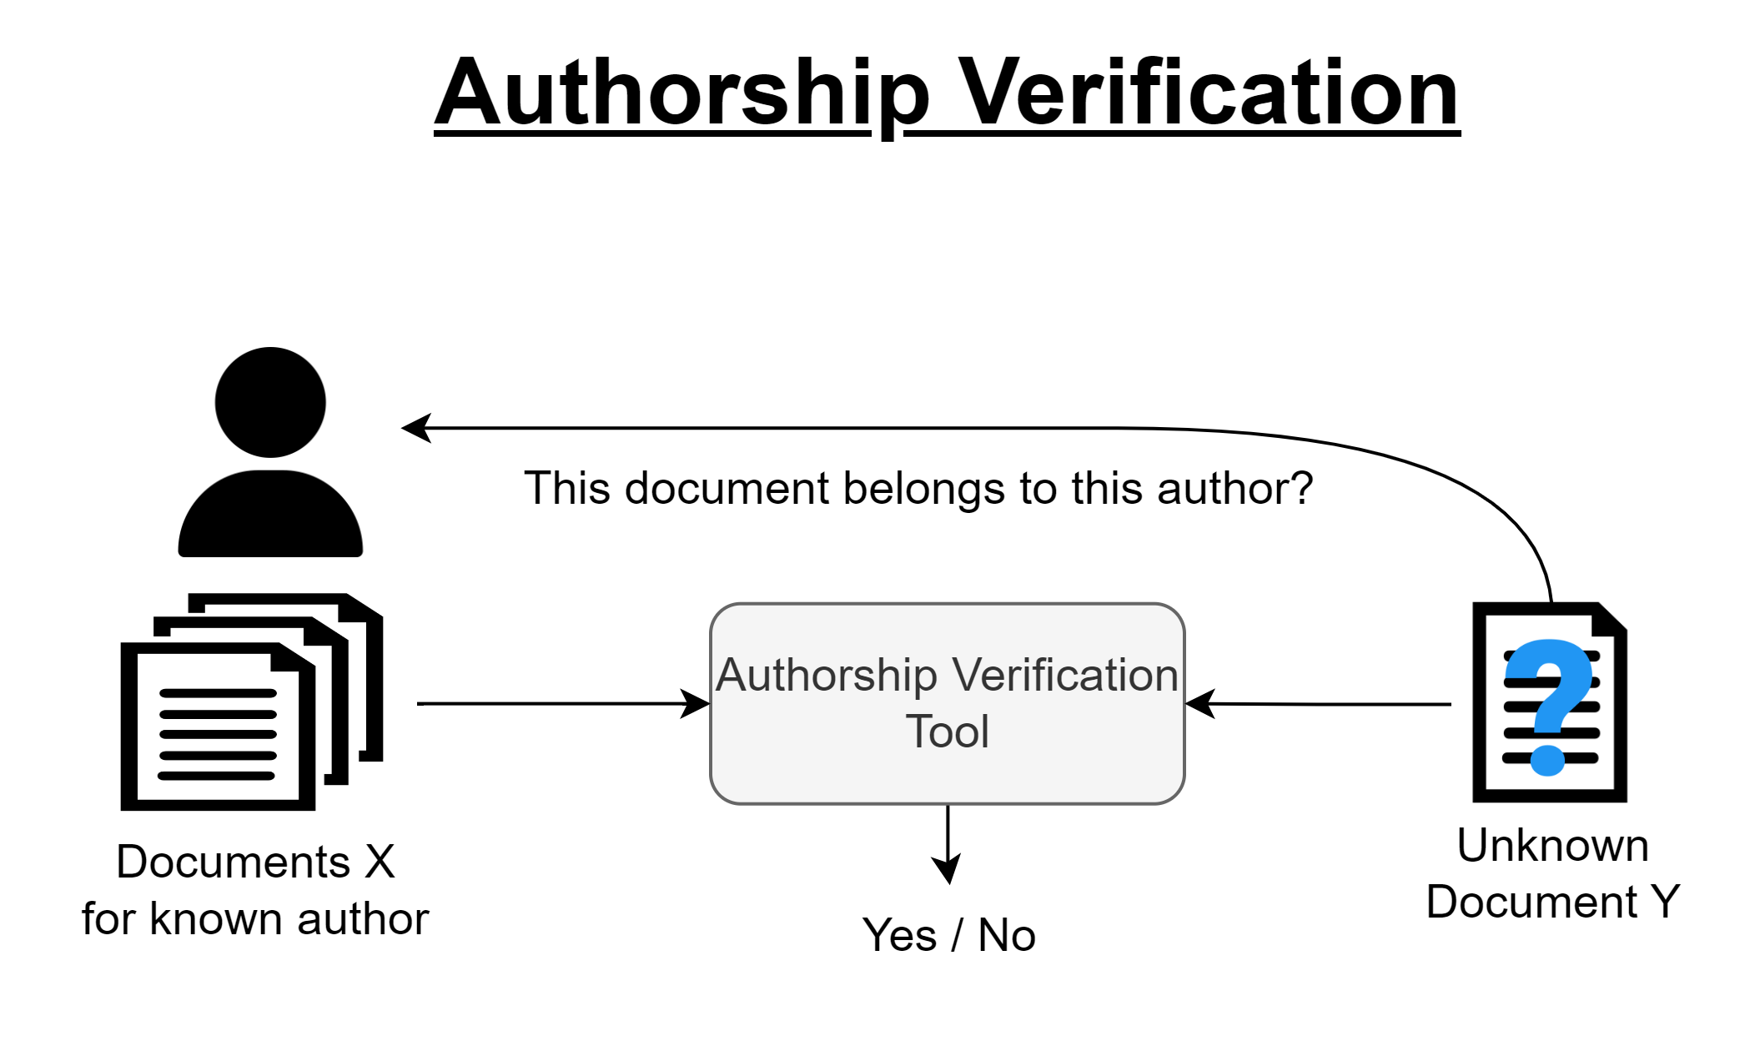

Usage of Text Graphs
Many research work solve different NLP tasks using the text graph approach:
Sentiment Analysis
Text Classification
Topic Modeling
Authorship Analysis
PAN is a workshop series and a networking
initiative for stylometry and digital text forensics
Notes:
- Now let’s talk about the usage of text graph
- There are many research work that solve different NLP tasks using this text graph approach: For instance We have found Works related to Sentiments Analysis / Text Calssification / Authorship Analysis
- But, we are more focus on Authoship Analysis área, specifically in the Authorship Verification task, We participate in the PAN competition every year
- PAN is a workshop series and a networking initiative for stylometry and digital text forensics
- And, this specific Authorship Verification task try to solve the following question..
whether two texts have been written by the same author comparing the texts' writing styles.
- There are different approaches to solve this task, in our case we commonly use text graph representation

Slide 14
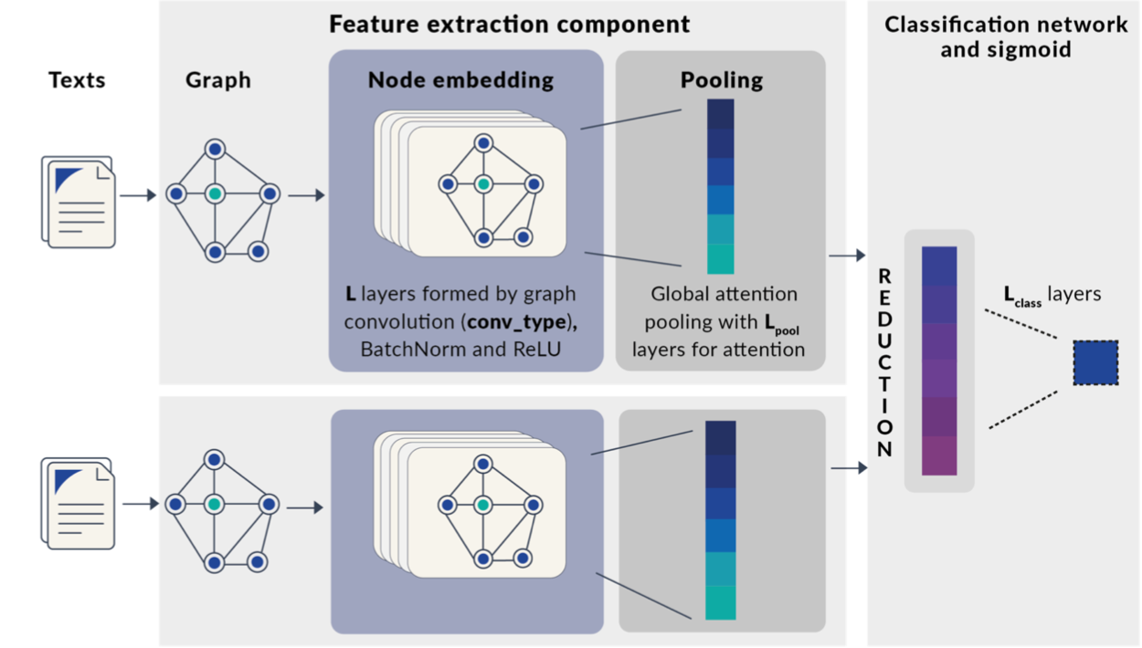
PAN CLEF 2022 – Authorship Verification
1. Embarcadero-Ruiz et al. [3], Graph-Based Siamese Network for Authorship Verification.
Applied to Authorship Verification task
Co-ocurrence Graph
Short, Med, Full Graph & nodes: (“word”, POS) | (POS, POS)
2nd place on PAN competition 2022
Results: Performance was better than baselines
Notes:
To mention some relevant and interesting works…

Slide 15
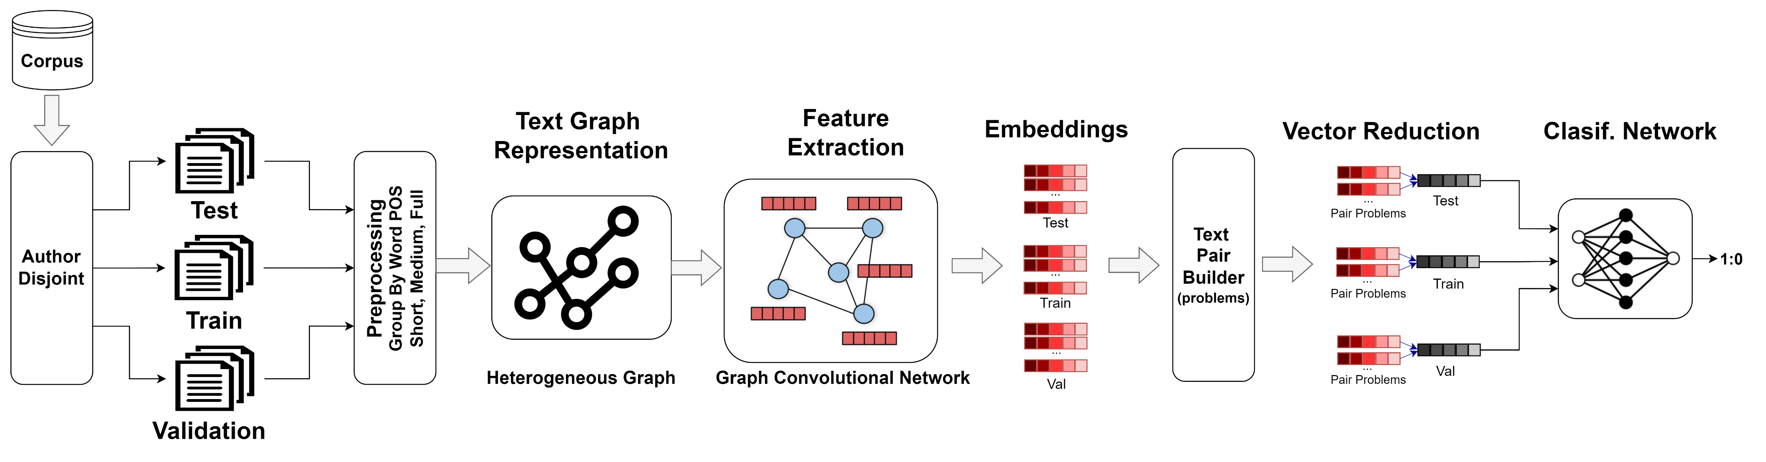
PAN CLEF 2023 – Authorship Verification
2. Andric-Valdez et al. [1], Heterogeneous-Graph Convolutional Network for Authorship Verification.
Graph Convolutional Network using Heterogeneous Graph
Better performance compared to the baselines
4th place (team) on PAN Competition 2023

Slide 16
Current and Future work for Text2graphAPI
Add new features/functionalities: Graph Exploration
Parameterization and Optimization
Generate new graph representations: Integrated Syntactic Graphs
Apply to other task: Style Change Detection, Authorship Profiling
Notes:
Applying in Authorship Verification task for PAN 2023
Adding new features/functionalities: Graph Exploration, Parameterization
Stylometryc analysis in order to extract some relevant features: node centrality, shortest part, node groups
of style features that can be statistically quantified, such as sentence length, vocabulary diversity, and frequencies (of words, word forms, etc.).
Generating new graph representations: Integrated Syntactic Graphs
Apply to other task: Style Change Detection, Authorship Profiling

Slide 17
“Graphs are the new frontier of deep learning” Jure Leskovec Thanks! Email: andric.valdez@gmail.com

Slide 18

Hands-On Collab Notebook
rb.gy/wi9o5

Slide 19

GitHub Repo DigitalHumanitiesSchool
rb.gy/7oxht

Slide 21
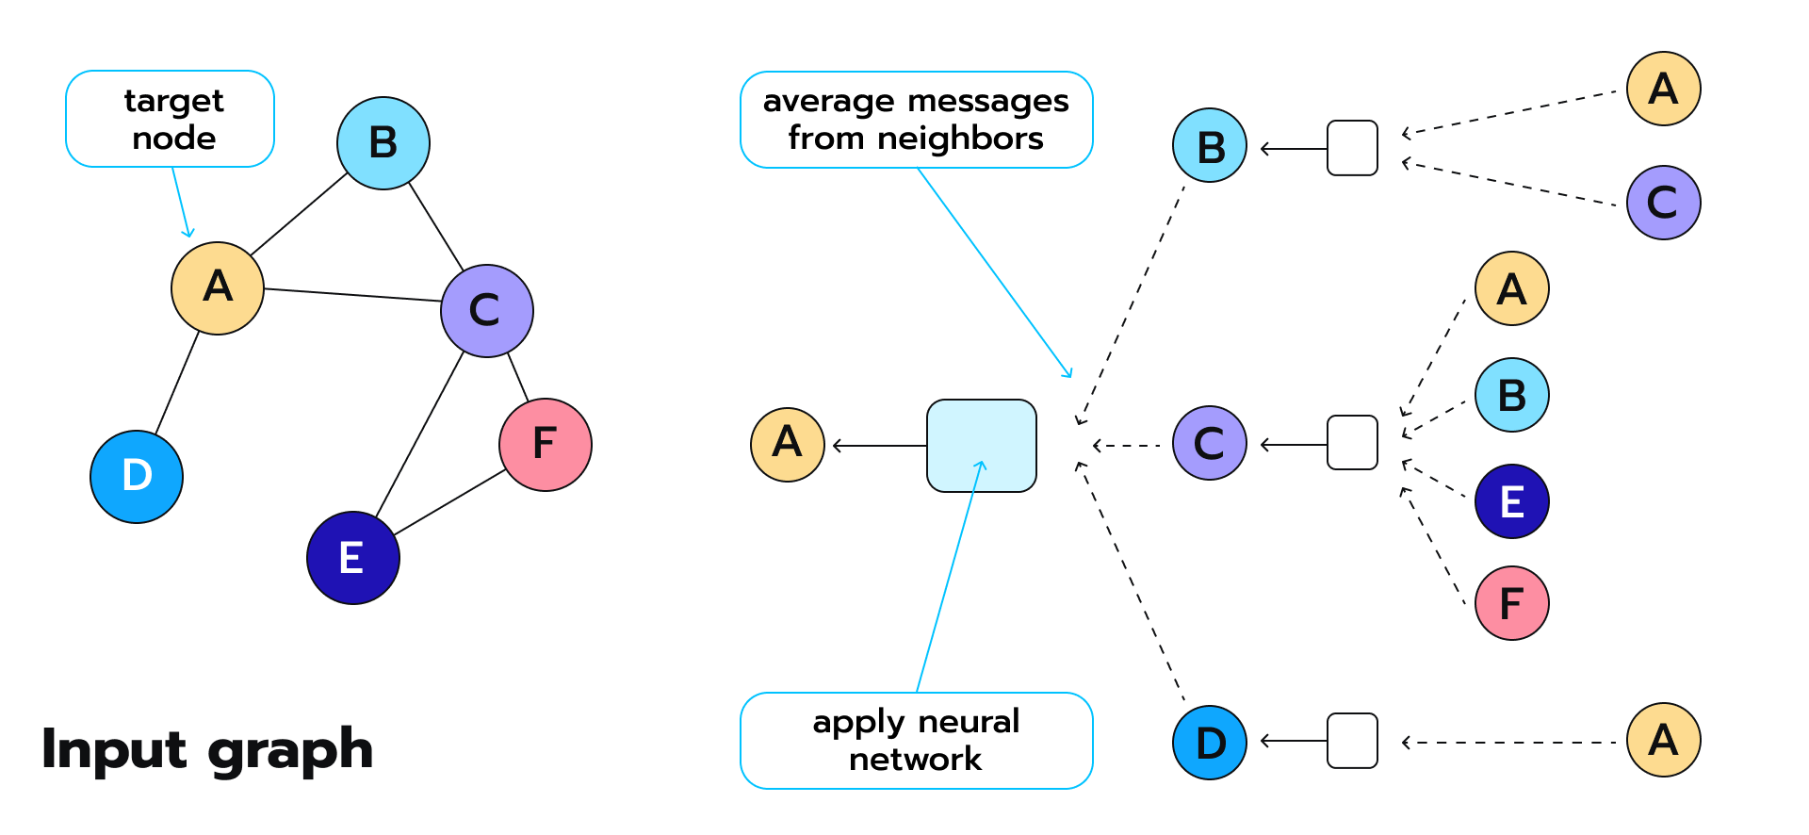
Graph Neural Networks

Slide 22
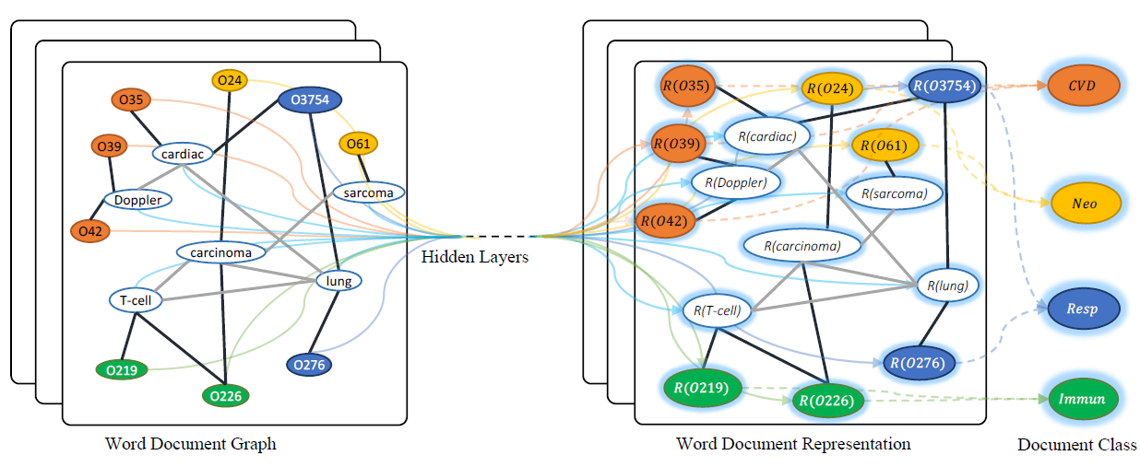
Text Graphs in Literature
1. Liang Yao et al. [1], Graph Convolutional Network for Text Classification.
Applied to the text classification task for different datasets (20 newsgroups)
Heterogeneous Graph
Better performance compared to the state of the art
Presents good performance with few training data
Notes:
Presents a Graph Convolutional Networks for Text Classification.
They Applied to the text classification task for different datasets (20 newsgroups)
Explain diagram…
their results demonstrate that a text GCN outperforms state-of-the-art methods for text classification.
Furthermore, their experimental results showed that the improvement of Text GCN compared to the state of the art become more prominent as we lower the percentage of training data.

Slide 23
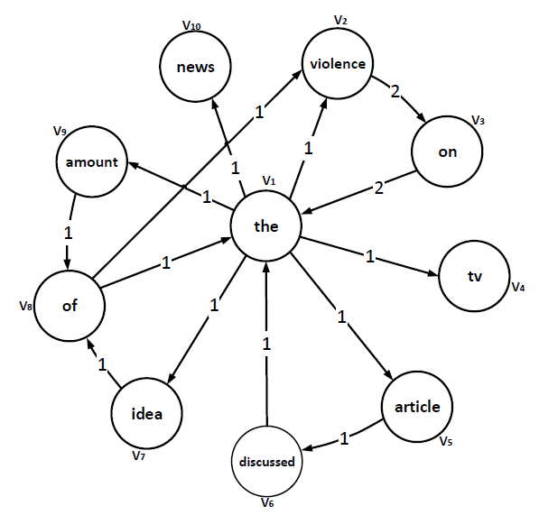
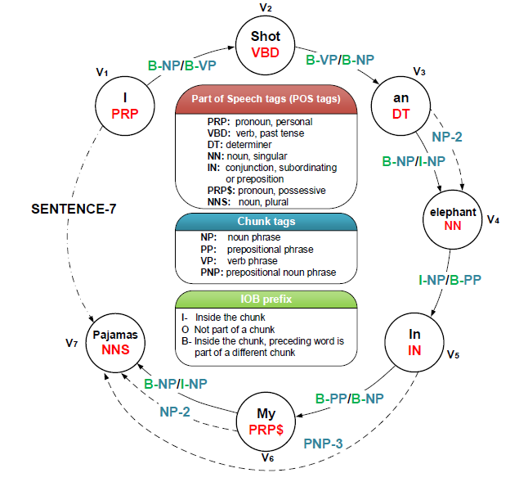
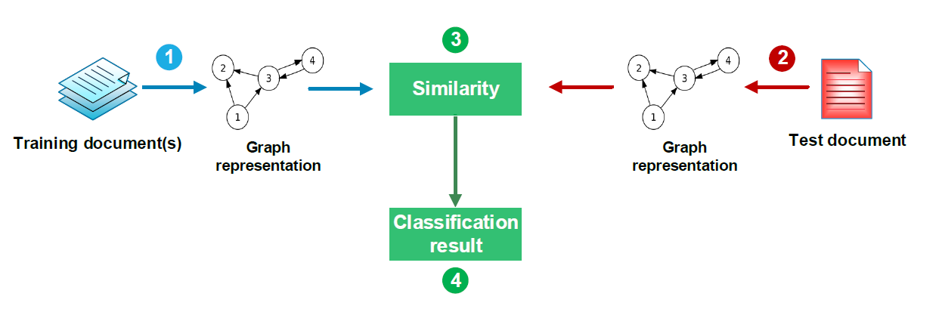
Text Graphs in Literature
2. Esteban-Castillo et al. [2], Text Analysis Using Different Graph-Based Representation.
Applied to the text classification tasks: Authorship Analysis
Two approaches based on supervised learning: : Feature Vector & Cosine Similarity
Co-Ocurrence Graph
Similar performance to traditional models
It could be used as a faster alternative compared to traditional methods
Notes:
Presents a Text Analysis Using Different Graph-Based Representation.
It is an overview of different graph-based representations to solve text classification tasks: Authorship Analysis
Its main purpose is to highlight the importance of using (co-occurrence) graphs as an alternative to traditional feature representation models such as vector representation.
Two approaches based on supervised learning: : Feature Vector & Cosine Similarity
Explain diagram…
Their results show similar performance to traditional models and tjeir approach It could be used as a faster alternative compared to traditional methods

Slide 24
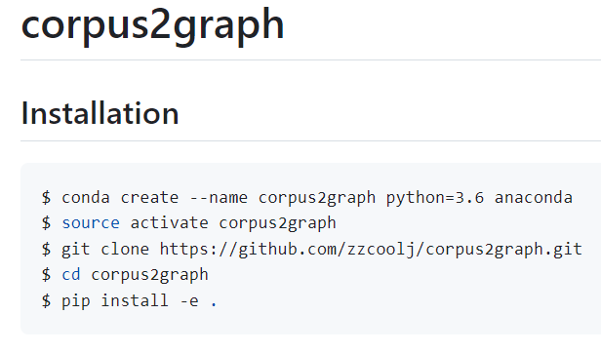
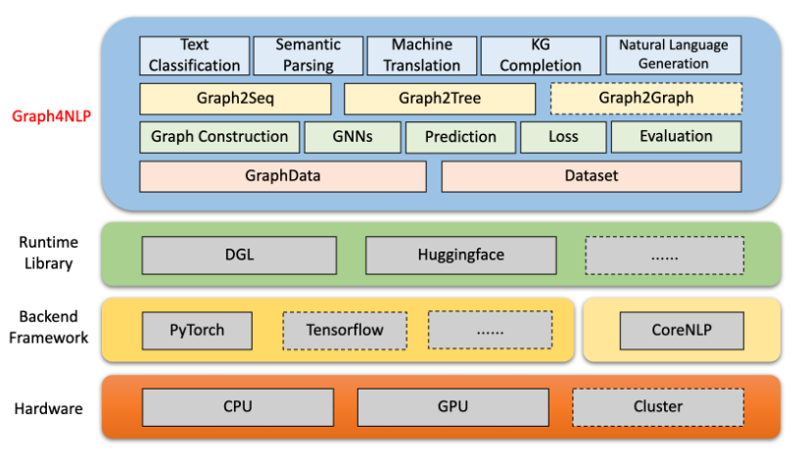
Tools to transform text to graph
Z. Zhang [4], corpus2graph: https://github.com/zzcoolj/corpus2graph
Lingfei Wu [5], Graph4NLP: https://github.com/graph4ai/graph4nlp
Notes:
Currently, there are few tools that exist to perform transformations from text to graphs.
but they have many limitations...

Slide 25
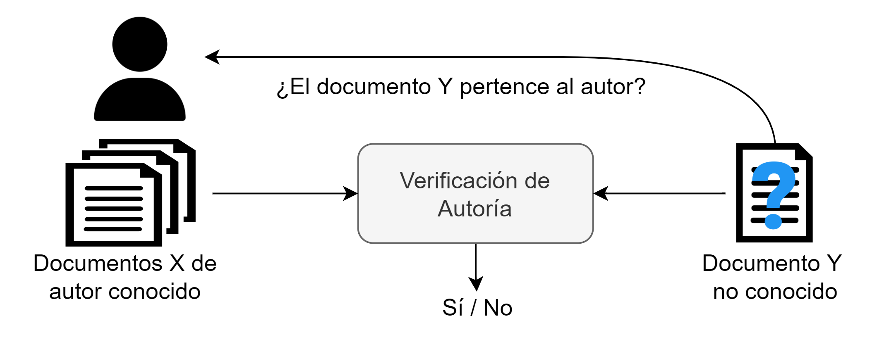
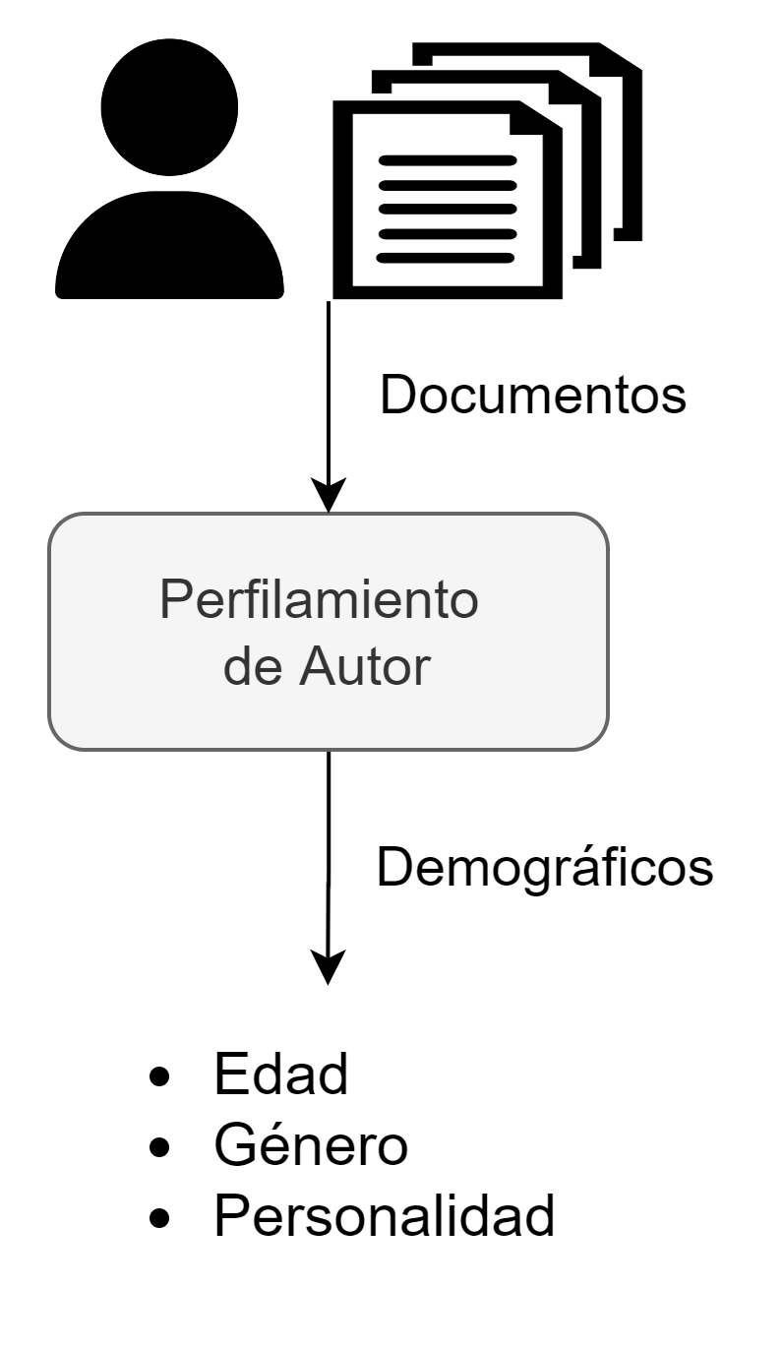
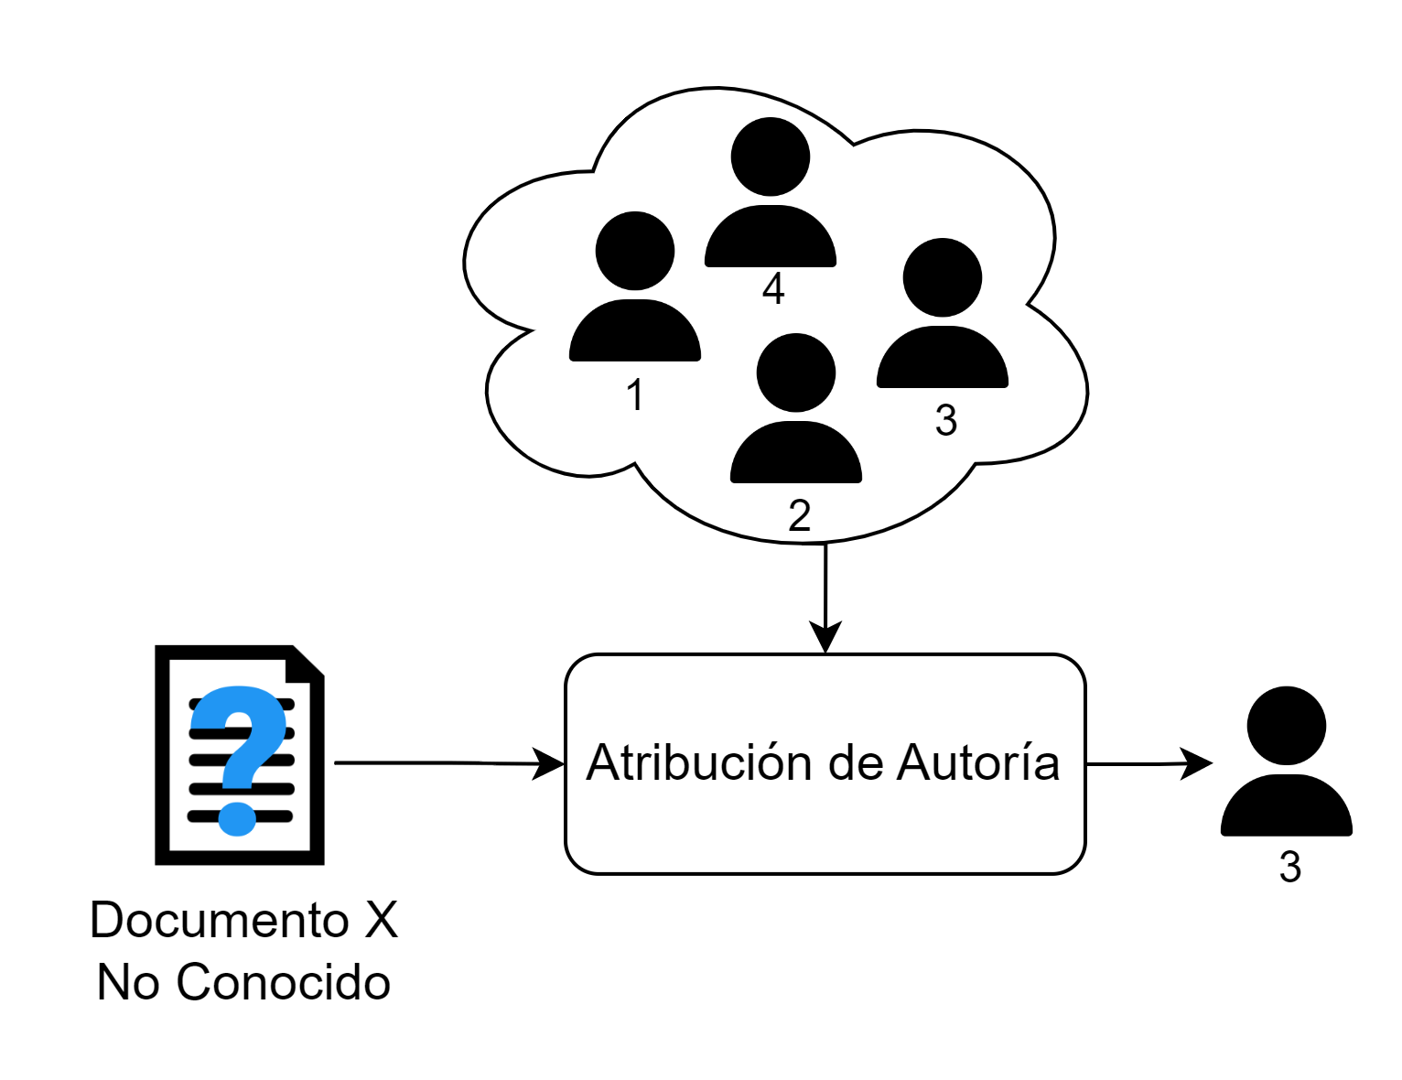
Análisis de Autoría
Verificación de Autoría
Perfilamiento de Autor
Atribución de Autoría

Slide 26
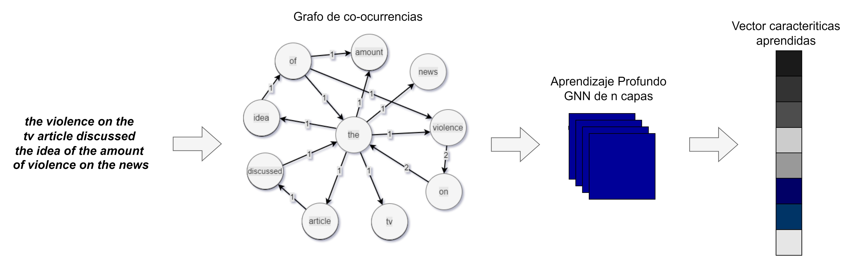
Redes Neuronales de Grafos
TEXTO: The violence on the TV. The article discussed the idea of the amount of violence on the news.

Slide 27

Resultados – Casos de Uso
Competición PAN at CLEF
Verificación Autoría
PAN 2022: Arquitectura GCN Siamesa - Gafo Co-ocurrencia
PAN 2023: Arquitectura GCN – Grafo Heterogéneo

Slide 28
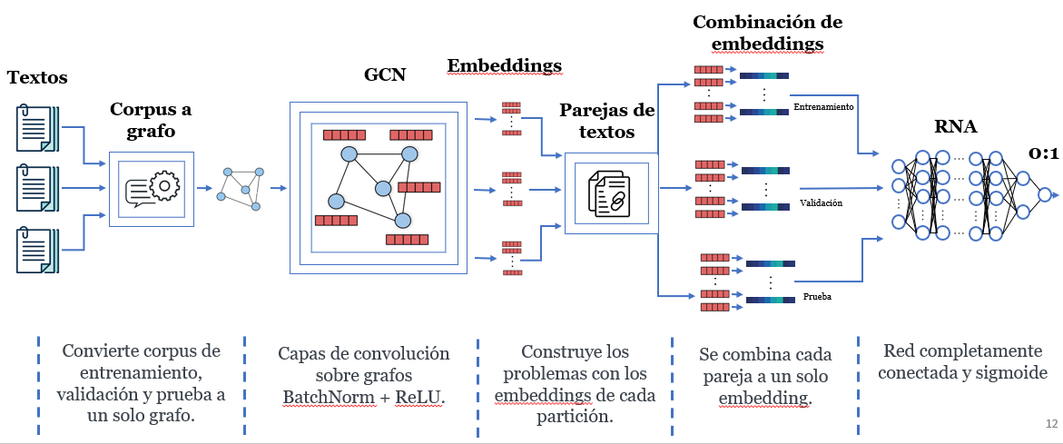
PAN 2023 - VA GCN con Grafo Heterogéneo
Usada para la tarea de verificación de autoría
Grafo Heterogéneo
Score Rendimiento 71 %
¿? lugar en la competición PAN

